Slide 1


Jinja
Template engine
Ehsan saeedi - Autumn2018

Slide 2
Outline
Introduction
What is jinja template engine?
Features
Who uses it?
Implementation & Architecture review
core component
API
Class Diagram
Design Decisions
Pros & Cons
Code Analyze
References

Slide 3
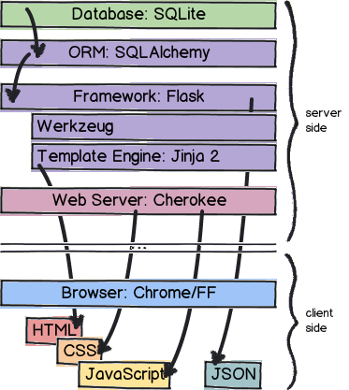
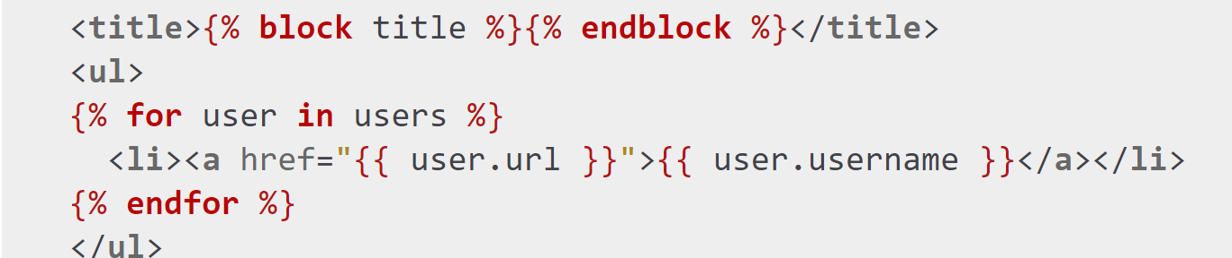
What is Jinja template engine?
An engine that:
enables you to use static template files in your application.
enables you to use templates and interpolate the variable in them,
instead of cluttering the code by generating HTML using string concatenating.
works as a compiler for your template
Notes:
Now, in the modern web world, we have less of static data and more of dynamic data being requested from clients and therefore sent by the server. The web totally depends on what the client is asking for, and on
A template contains variables which are replaced by the values which are passed in when the template is rendered. Variables are helpful with the dynamic data.which user is signing in and who is logging out. So, Jinja2 templating is being used.

Slide 4
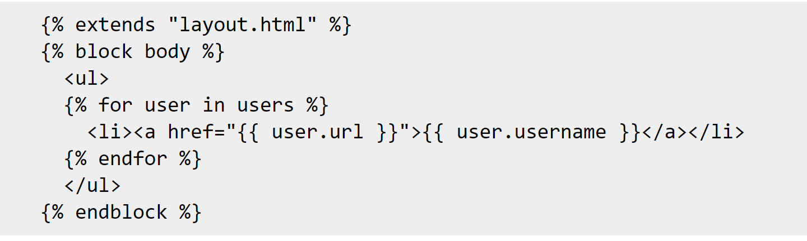
Features
A full featured, most used template engine for Python
Inspired by Django's templating system
Full unicode support
Configurable syntax
Optional integrated sandboxed execution environment
Notes:
Configurable syntax. For instance you can reconfigure Jinja2 to better fit output formats such as LaTeX or JavaScript.
The Jinja2 sandbox can be used to evaluate untrusted code. Access to unsafe attributes and methods is prohibited.
Sandboxed execution mode. Every aspect of the template execution is monitored and explicitly whitelisted or blacklisted, whatever is preferred. This makes it possible to execute untrusted templates.

Slide 5
Features(Cont’d)
High performance
Template inheritance
Powerful automatic HTML escaping system
Who uses it?
Mozilla
SourceForge
Instagram
NPR
Notes:
High performance with just in time compilation to Python bytecode. Jinja2 will translate your template sources on first load into Python bytecode for best runtime performance.
powerful automatic HTML escaping system for cross site scripting prevention.
Jinja 2 has a powerful automatic HTML Escaping, which helps preventing Cross-site Scripting (XSS Attack). There are special characters like >,<,&, etc. which carry special meanings in the templates. So, if you want to use them as regular text in your documents then, replace them with entities. Not doing so might lead to XSS-Attack.
Template inheritance makes it possible to use the same or a similar layout for all templates.
Template designer helpers. Jinja2 ships with a wide range of useful little helpers that help solving common tasks in templates such as breaking up sequences of items into multiple columns and more

Slide 6
terrible idea to put Logic into Templates?
Remove as much logic from templates as possible,
But
Some amount of logic is required in templates to keep everyone happy
Notes:
But templates without any logic mean that you have to do all the processing in the code which is boring and stupid. A template engine that does that is shipped with Python and called string.Template. Comes without loops and if conditions and is by far the fastest template engine you can get for Python.
nd Jinja leaves it pretty much to you how much logic you want to put into templates. There are some restrictions in what you can do and what not.
Jinja2 neither allows you to put arbitrary Python code into templates nor does it allow all Python expressions. The operators are limited to the most common ones and more advanced expressions such as list comprehensions and generator expressions are not supported. This keeps the template engine easier to maintain and templates more readable.

Slide 7
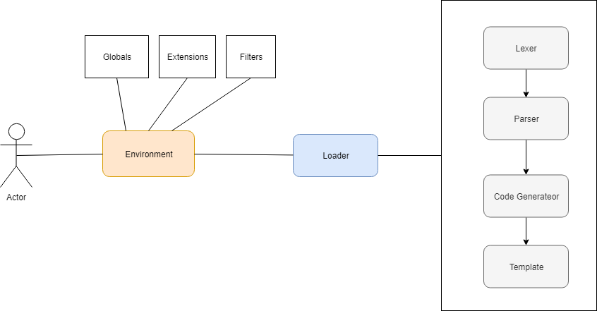
Implementation & Architecture review
Notes:
Instances of this class may be modified if they are not shared and if no template was loaded so far. Modifications on environments after the first template was loaded will lead to

Slide 8
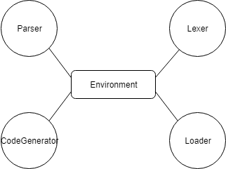
Implementation & Architecture review (Cont’d)
core component
The core component of Jinja is the Environment.
Contains important shared variables like configuration, filters, globals
Used to load templates
Notes:
Instances of this class may be modified if they are not shared and if no template was loaded so far. Modifications on environments after the first template was loaded will lead to

Slide 9
Implementation & Architecture review (Cont’d)
API
High level API
use in the application to load and render Jinja2 templates
Low level API
exposes functionality
useful to understand some implementation details
advanced extension techniques
not recommended to be used
Meta API
some information about abstract syntax trees (AST)
help applications to implement more advanced template concepts
Notes:
Returns a set of all variables in the AST that will be looked up from the context at runtime.

Slide 10
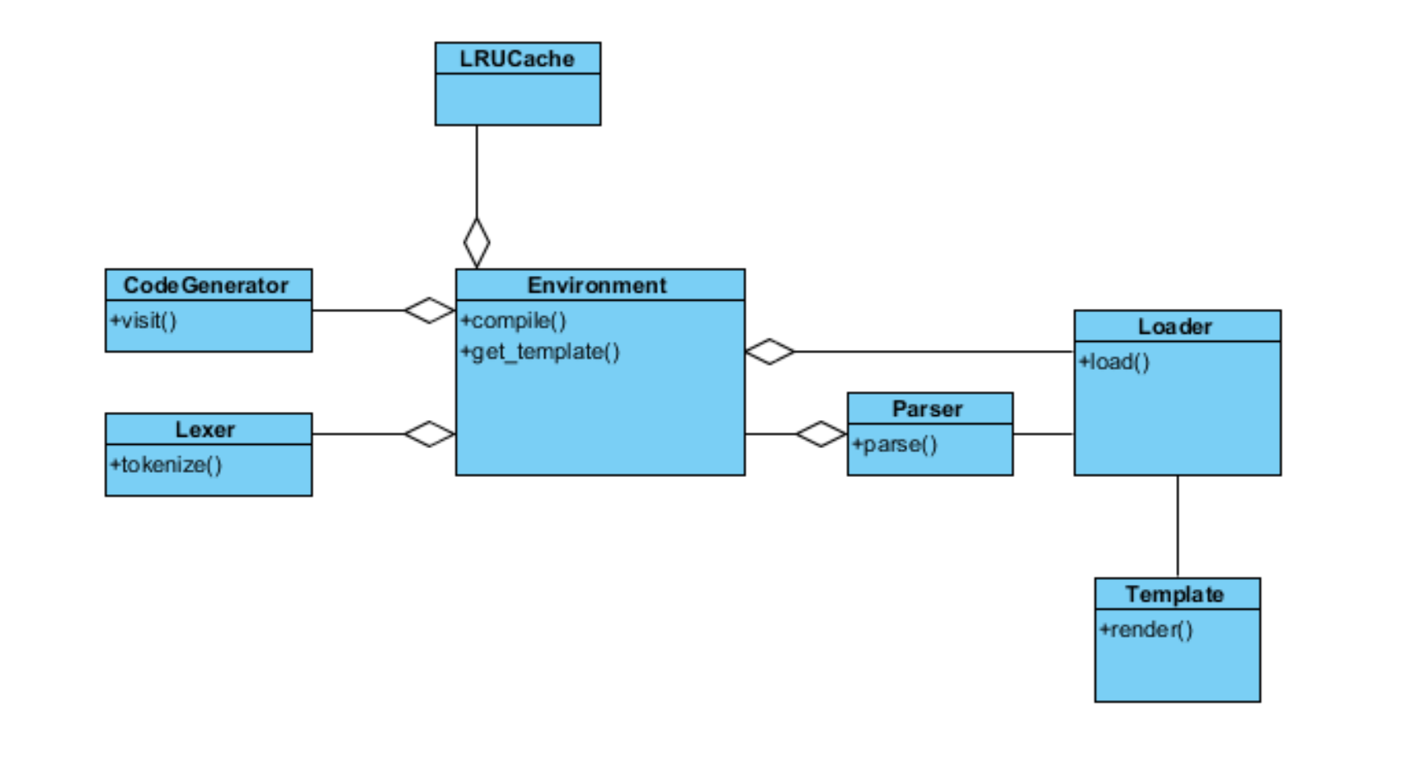
Implementation & Architecture review (Cont’d)
Class Diagram

Slide 11
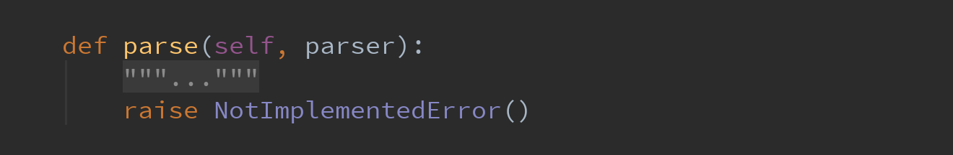
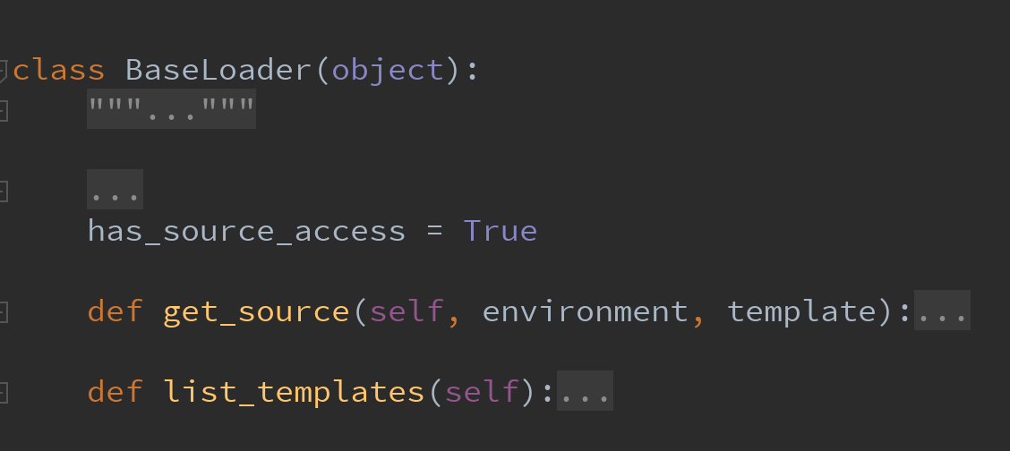
Implementation & Architecture review (Cont’d)
Design decisions
Use of LRU Cache for performance
Custom Extensions
add extra filters, tests, globals or even extend the parser
add custom tags to Jinja2
additional extensions cannot be added when environment is created
Inherit from extension class and implements its methods
Custom Loaders
Inherit from base loader and implements its methods

Slide 12
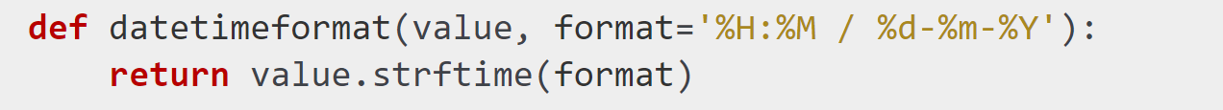

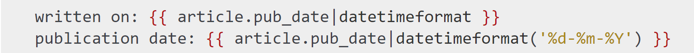
Implementation & Architecture review (Cont’d)
Design decisions(cont’d)
Custom Filter
Use a dictionary(Map) of filters for environment(key-> filtername , value-> filter function)

Slide 13

Implementation & Architecture review (Cont’d)
Design decisions(cont’d)
Sandboxed Environment
works like the regular environment
but tells the compiler to generate sandboxed code
Notes:
subclasses of this environment may override the methods
that tell the runtime what attributes or functions are safe to access
The Jinja2 sandbox alone is no solution for perfect security.
Also the sandbox is only as good as the configuration. We strongly recommend only passing non-shared resources to the template and use some sort of whitelisting for attributes.
Also keep in mind that templates may raise runtime or compile time errors, so make sure to catch them.
def test_immutable_environment(self):
env = ImmutableSandboxedEnvironment()
self.assert_raises(SecurityError, env.from_string(
'{{ [].append(23) }}').render)
self.assert_raises(SecurityError, env.from_string(
'{{ {1:2}.clear() }}').render)

Slide 14
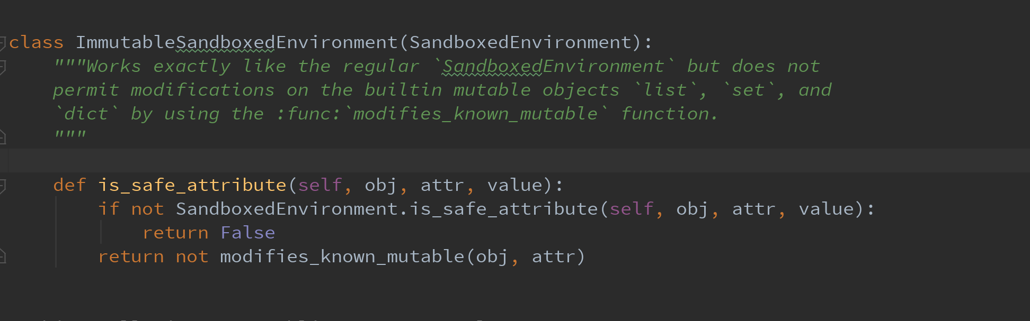
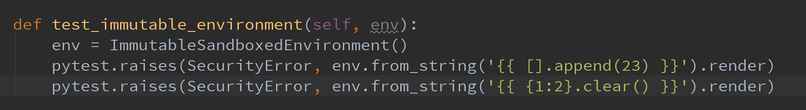
Implementation & Architecture review (Cont’d)
Sandboxed Environment Example
Notes:
subclasses of this environment may override the methods
that tell the runtime what attributes or functions are safe to access
The Jinja2 sandbox alone is no solution for perfect security.
Also the sandbox is only as good as the configuration. We strongly recommend only passing non-shared resources to the template and use some sort of whitelisting for attributes.
Also keep in mind that templates may raise runtime or compile time errors, so make sure to catch them.
def test_immutable_environment(self):
env = ImmutableSandboxedEnvironment()
self.assert_raises(SecurityError, env.from_string(
'{{ [].append(23) }}').render)
self.assert_raises(SecurityError, env.from_string(
'{{ {1:2}.clear() }}').render)

Slide 15
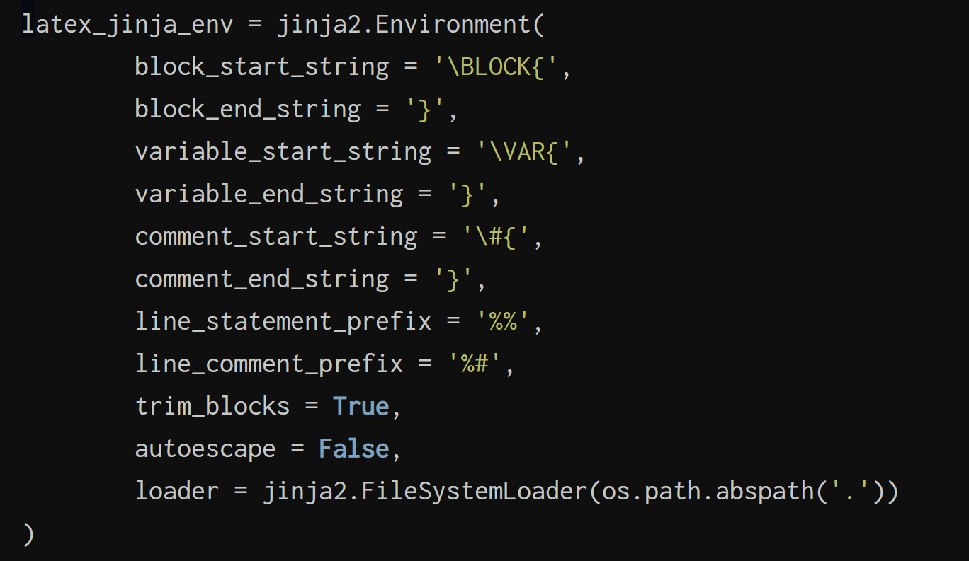
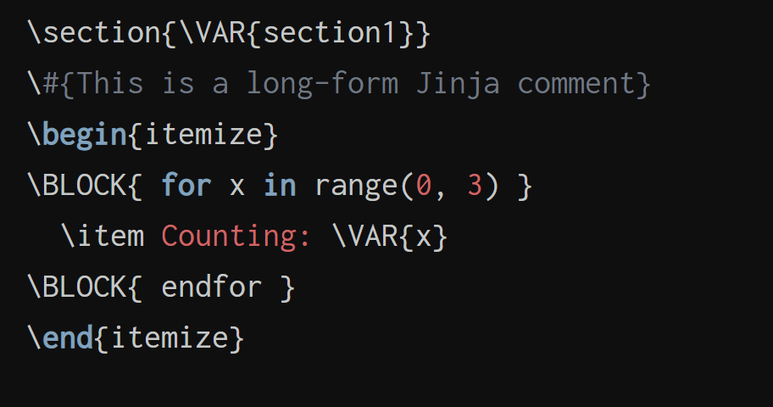
Implementation & Architecture review (Cont’d)
Design decisions(cont’d)
Configurable syntax
Notes:
subclasses of this environment may override the methods
that tell the runtime what attributes or functions are safe to access
The Jinja2 sandbox alone is no solution for perfect security.
Also the sandbox is only as good as the configuration. We strongly recommend only passing non-shared resources to the template and use some sort of whitelisting for attributes.
Also keep in mind that templates may raise runtime or compile time errors, so make sure to catch them.
def test_immutable_environment(self):
env = ImmutableSandboxedEnvironment()
self.assert_raises(SecurityError, env.from_string(
'{{ [].append(23) }}').render)
self.assert_raises(SecurityError, env.from_string(
'{{ {1:2}.clear() }}').render)

Slide 16
Pros & Cons
Pros
Custom Filters, Extensions, Loader
A configurable environment
Use of iterator in implementation
Notes:
As of Jinja 2.4 this can also be a callable that is passed the template name and has to return True or False depending on autoescape should be enabled by default.

Slide 17
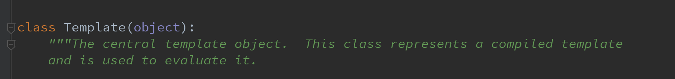
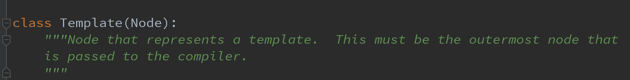
Pros & Cons(cont’d)
Cons
Duplicate class name

Slide 18
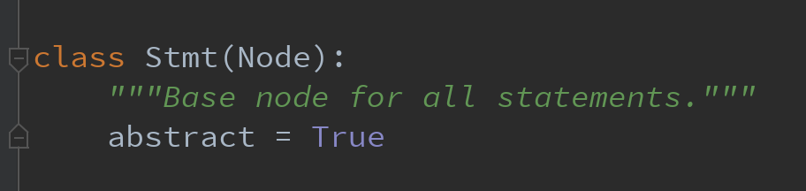
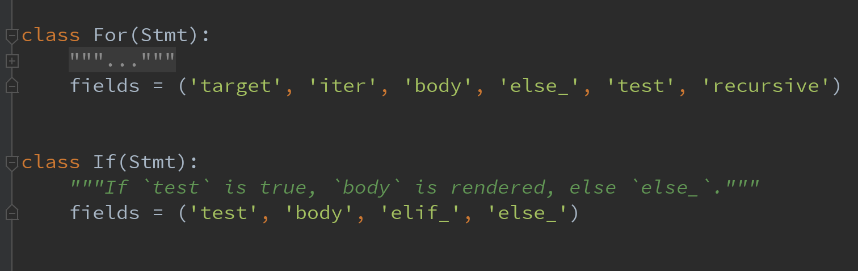
Pros & Cons(cont’d)
Cons
Inheritance to add one attribute

Slide 19
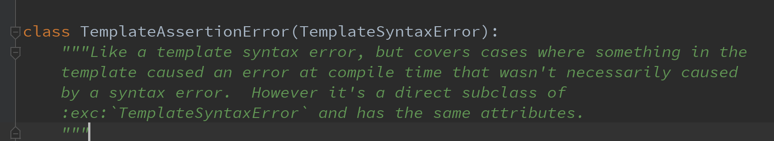
Pros & Cons(cont’d)
Cons
Inheritance to add nothing!

Slide 20
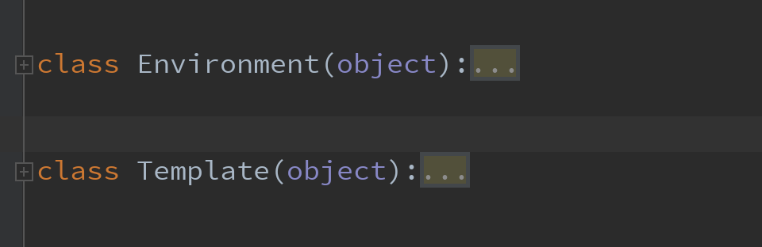
Pros & Cons(cont’d)
Cons
Modules naming
Environment module and its classes
Core environments and code complexity

Slide 21
Code Analyze
Blank Lines 2,080
Classes 158
Code Lines 7,301
Comment Lines 2,808
Comment to Code Ratio 0.38
Declarative Statements 1,085
Executable Statements 4,905
Files 26
Functions 733
Lines 12,172

Slide 22
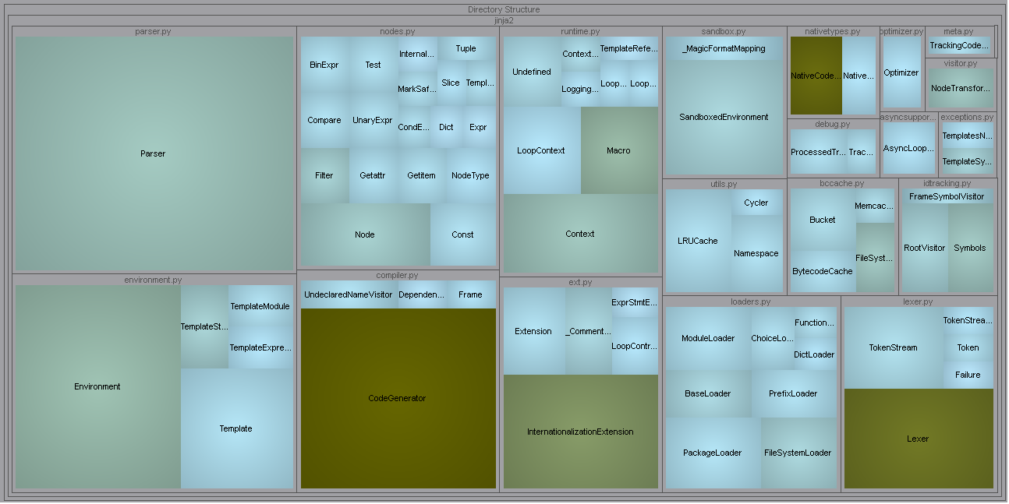
Code Analyze

Slide 23
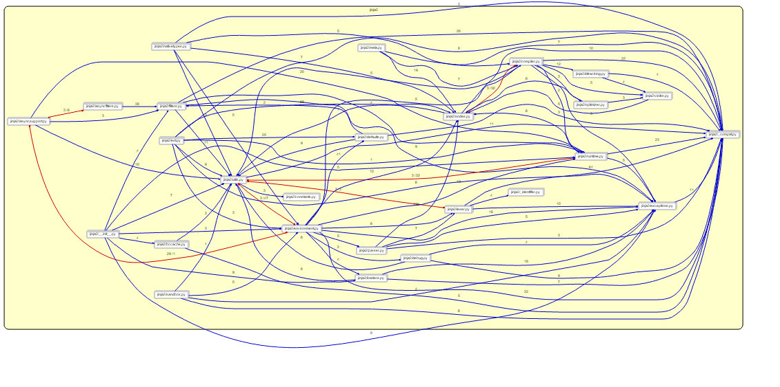
Code Analyze

Slide 24
References
http://jinja.pocoo.org
https://expressjs.com/en/guide/using-template-engines.html
https://www.w3.org/International/questions/qa-escapes
https://www.danstools.com/html-escape-unescape/

